Slide 1
Applying For Emergency Funding Under the Paycheck Protection Plan (PPP)
Alex Thiersch, CEO AmSpa
Patrick O’Brien, Legal Counsel, AmSpa

Slide 2
Key Dates: April 3, 2020 (this Friday)
Small business applications may be submitted through existing SBA lenders
April 10, 2020 – independent contractors and self-employed individuals may apply

Slide 3
Numerous Resources Added Yesterday by Department of Treasury
https://home.treasury.gov/system/files/136/PPP%20Borrower%20Information%20Fact%20Sheet.pdf

Slide 4
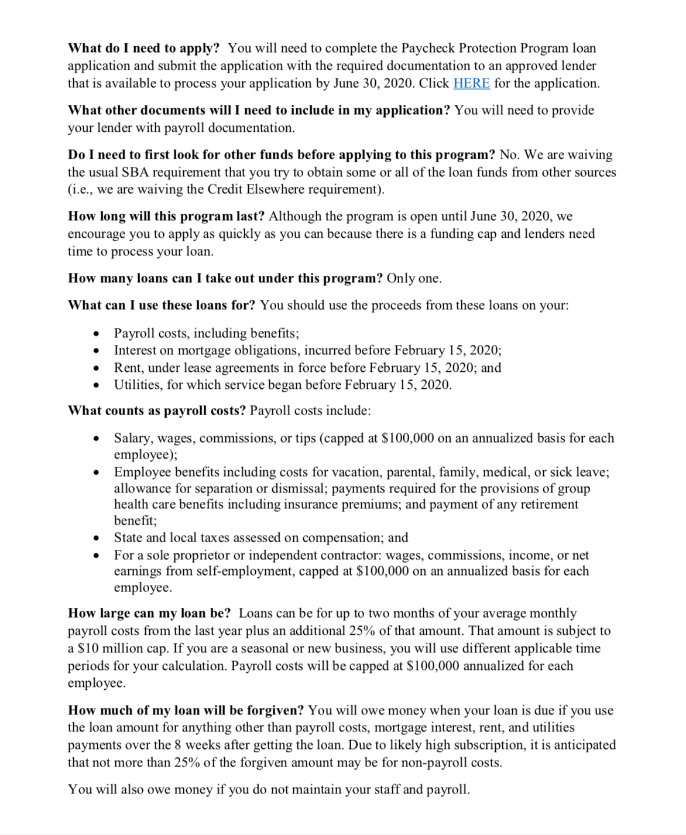
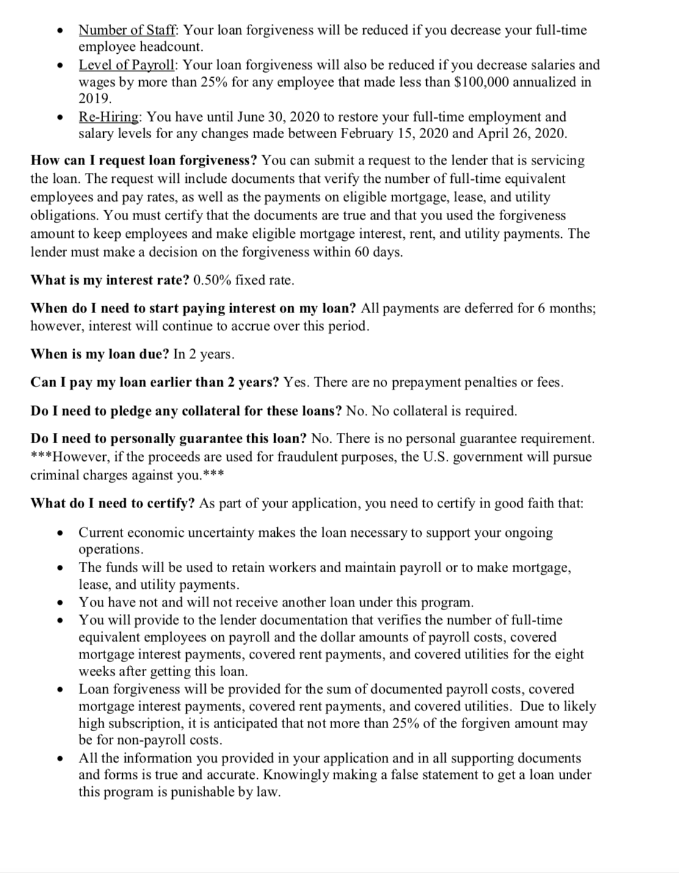
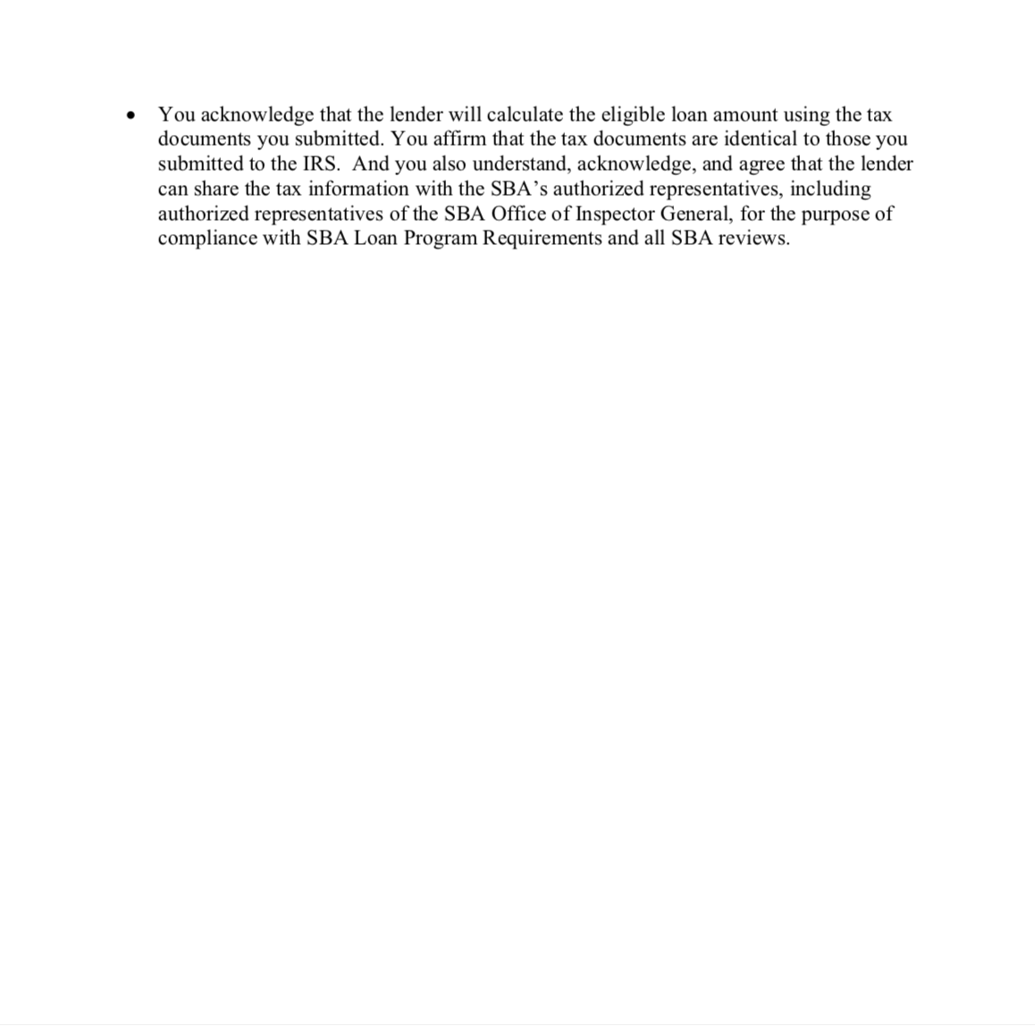

Slide 5
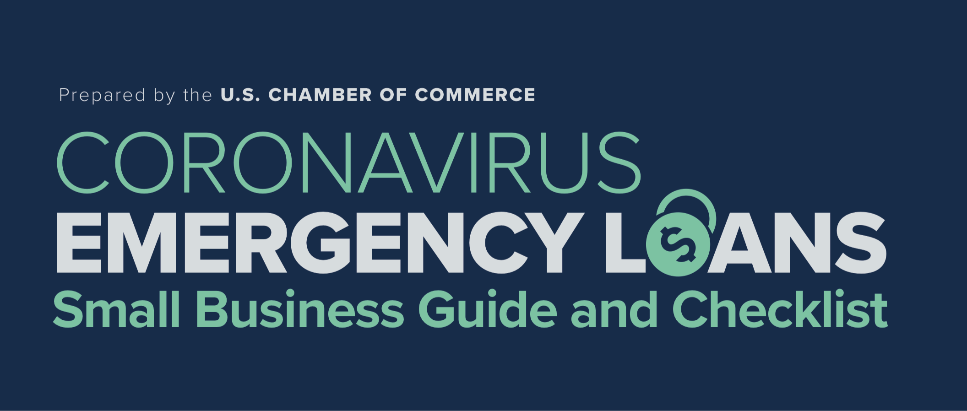
Additional Resources…
https://www.uschamber.com/sites/default/files/023595_comm_corona_virus_smallbiz_loan_final.pdf

Slide 6
Remember!!!
Friday, April 3, 2020

Slide 7
Where Should I Apply
Initially, SBA Approved Lender
Ultimately, any FDIC Insured Bank

Slide 8
Practical Tip:
Contact your business banker
(even if not an SBA Lender)
Banks will service existing relationships first

Slide 9
Who Can Apply:
Any business with under 500 employees
Aggregate number of employees counted
Some exclusions for franchises/other industries

Slide 10
How Much Can You Get?
2.5 times your average monthly
payroll costs for the last year
$10 million max

Slide 11
This is free money
100% of the loan is forgivable, provided…
You use the money for authorized expenses,
You retain your employees,
You don’t reduce their pay by 25% or more.

Slide 12
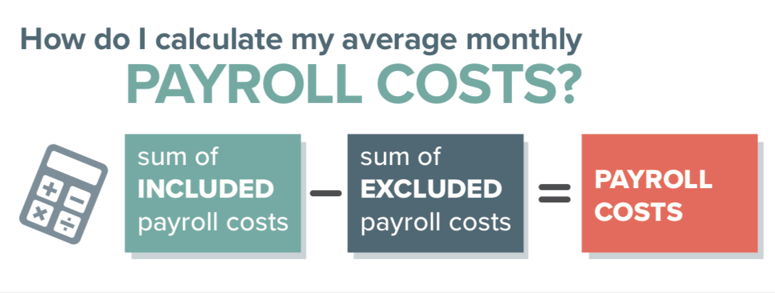

Slide 13
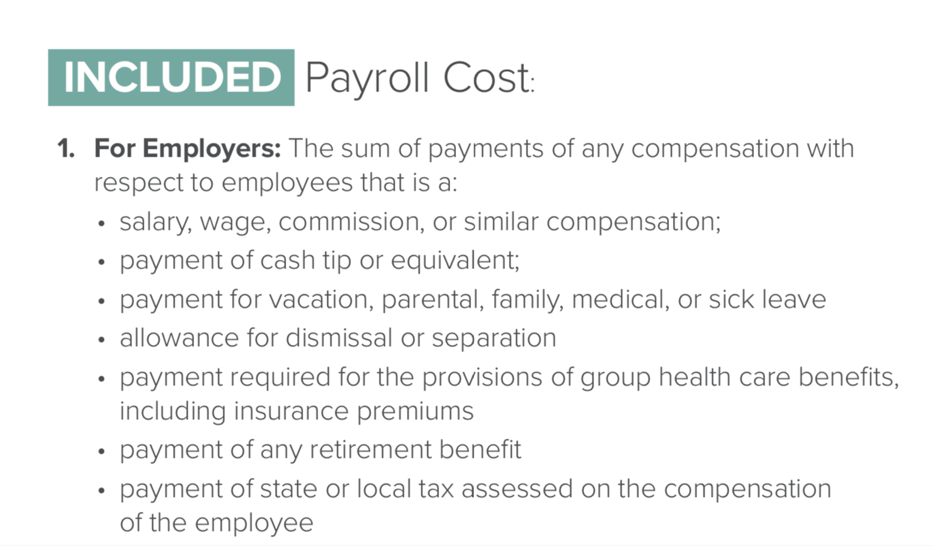
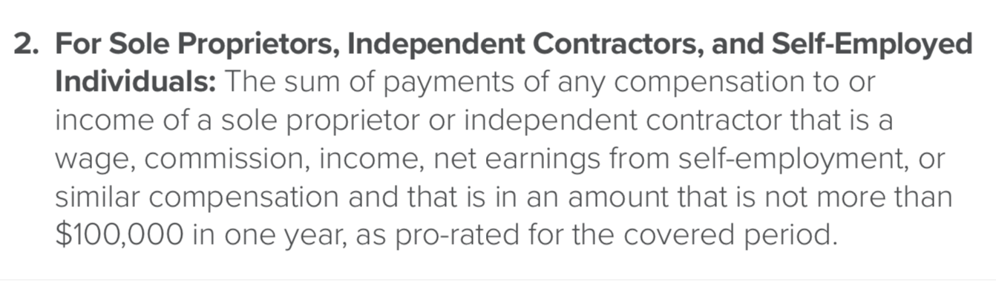

Slide 14
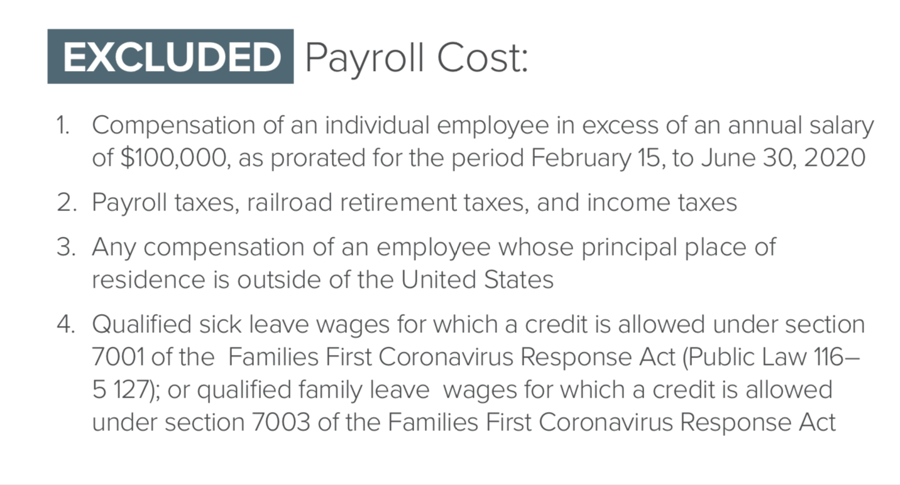

Slide 15
$1,000,000 in total annual payroll costs
Monthly Average is $83,333.33 ($1,000,000 / 12)
But…
2 employees earn $150,000…
…so $100k total may not be included in Payroll Costs
Total adjusted annual Payroll Cost is $900,000
Monthly Average is $75,000 ($900,000 / 12)
Total Loan amount = $187,500.00 ($75,000 x 2.5)

Slide 16
How Much Will Be Forgiven?
100% of the loan is forgivable, provided the amount borrowed is spent on the following expenses within 8 weeks following the loan:
    Payroll costs, including benefits;
    Interest on mortgage obligations, incurred before February 15, 2020;
    Rent, under lease agreements in force before February 15, 2020; and
    Utilities, for which service began before February 15, 2020.
But…
    75% should be towards payroll
    The loan forgiveness cannot exceed the principal.

Slide 17
How can the forgiveness be reduced?
Number of Staff: Your loan forgiveness will be reduced if you decrease your full-time employee headcount.
Level of Payroll: Your loan forgiveness will be reduced if you decrease salaries and wages by more than 25% for any employee that made less than $100,000 annualized in 2019.
But…
Re-Hiring: You have until June 30, 2020 to restore your full-time employment and salary levels for any changes made between February 15, 2020 and April 26, 2020.

Slide 18
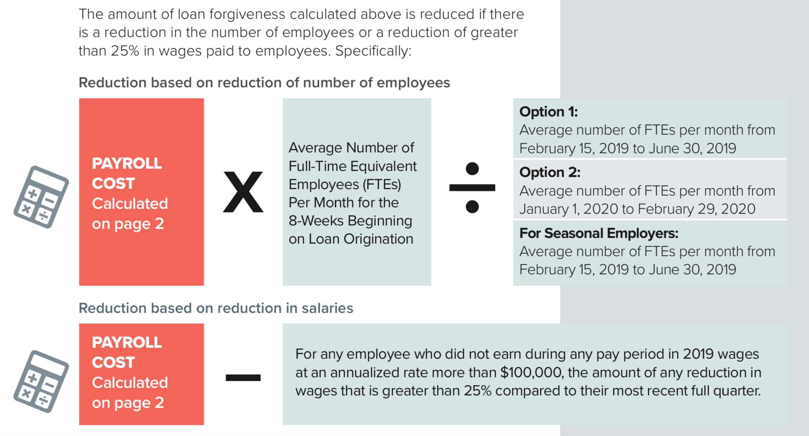

Slide 19
Terms and Conditions…
    What is my interest rate? 0.50% fixed rate.
    When do I need to start paying interest on my loan? All payments are deferred for 6 months; however, interest will continue to accrue over this period.
    When is my loan due? In 2 years.
    Can I pay my loan earlier than 2 years? Yes. There are no prepayment penalties or fees.
    Do I need to pledge any collateral for these loans? No. No collateral is required.
    Do I need to personally guarantee this loan? No. There is no personal guarantee requirement.

Slide 20
Other Options…
50% Employee Retention Tax Credit: This program allows employers (regardless of size) uniquely affected by COVID-19 to claim a refundable tax credit against the employer portion of payroll tax equal to 50% of certain wages paid to an employee between March 13, 2020 through the end of the year.
Social Security Tax Deferral: Another provision that is available to employers of all sizes is the ability to defer the payment of the employer portion of Social Security taxes (6.2% of wages) for the remainder of 2020. Fifty percent of those deferred taxes would have to be repaid by the end of 2021, with the remainder due by the end of 2022.
Economic Injury Disaster Loans (“EIDL”) (7(b)): The SBA will work directly with state Governors to provide targeted, low-interest loans to small businesses and nonprofits that have been severely impacted by the
Coronavirus (COVID-19). The SBA’s Economic Injury Disaster Loan program provides small businesses with working capital loans of up to $2 million that can provide vital economic support to small businesses to help overcome the temporary loss of revenue they are experiencing.

Slide 21
Some Considerations
Families First Coronavirus Response Act: This Law created paid sick leave and paid family leave benefits for employees effected by COVID-19. These are effective April 1 to Dec 31 and paid by the employer. In some instances the employer may be reimbursed for some of these payments.
Expanded Unemployement Benefits: The CARES Act expands unemployment compensation benefits both in who can apply and for how long they may receive them. Additionally the CARES act provides $600 per week extra (to July 31st) for those on unemployment.
$10k emergency grant for EIDL: Those applying for an SBA Economic Injury Disaster Loan can request an advance grant of up to $10k. This money does not need to be repaid whether or not the loan is made. These loans can be refinanced into the PPP loan but the $10k reduces the forgivable amount.

Slide 22
Restrictions…
If you obtain one of the new SBA loans, you are not eligible for the 50% employee retention tax credit.
If you have a new SBA loan forgiven, you cannot take advantage of the Social Security tax deferral.
If you claim the 50% employee retention credit, you will no longer be eligible for an SBA loan.
If you take advantage of the Social Security tax deferral, you will no longer be eligible to have your SBA loan forgiven.
If you’ve already applied for or received SBA EIDL loans, you can refinance the EIDL into the PPP for loan forgiveness purposes. While you can apply for both, you CANNOT take out an EIDL and a PPP loan at the same time and for the same purposes.

Slide 23
Things to do NOW…
1. Gather the following:
  Payroll tax returns for the four quarters of 2019, ending on 12/31/19, and payroll tax records for January and February 2020 showing evidence of deposits;
  12 months of balance sheets and operating statements starting in March 2019 and ending in February 2020;
  Most recent filed business tax return (2018 or 2019); and
  12-month summary of operating expenses.
2. Download and fill out the application:
https://home.treasury.gov/system/files/136/Paycheck-Protection-Program-Application-3-30-2020-v3.pdf
3. Contact your banker

Slide 24
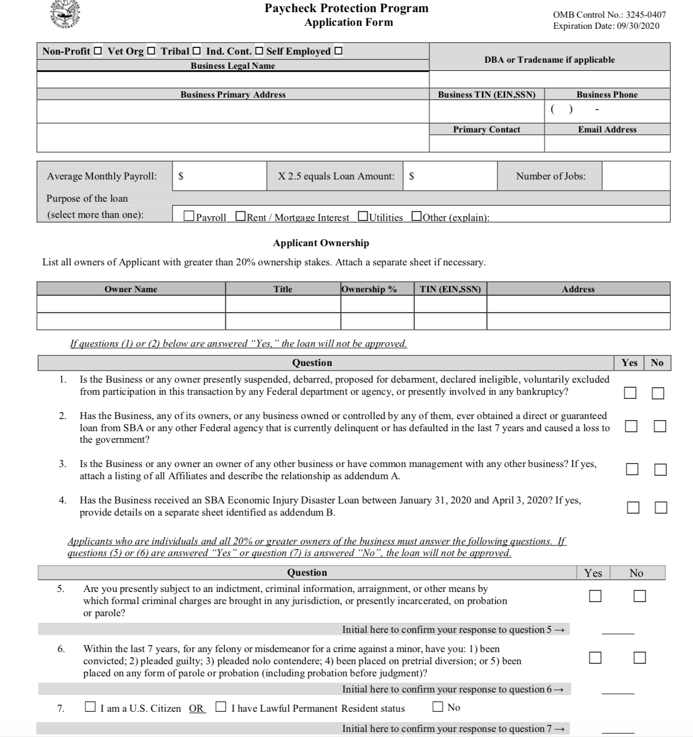
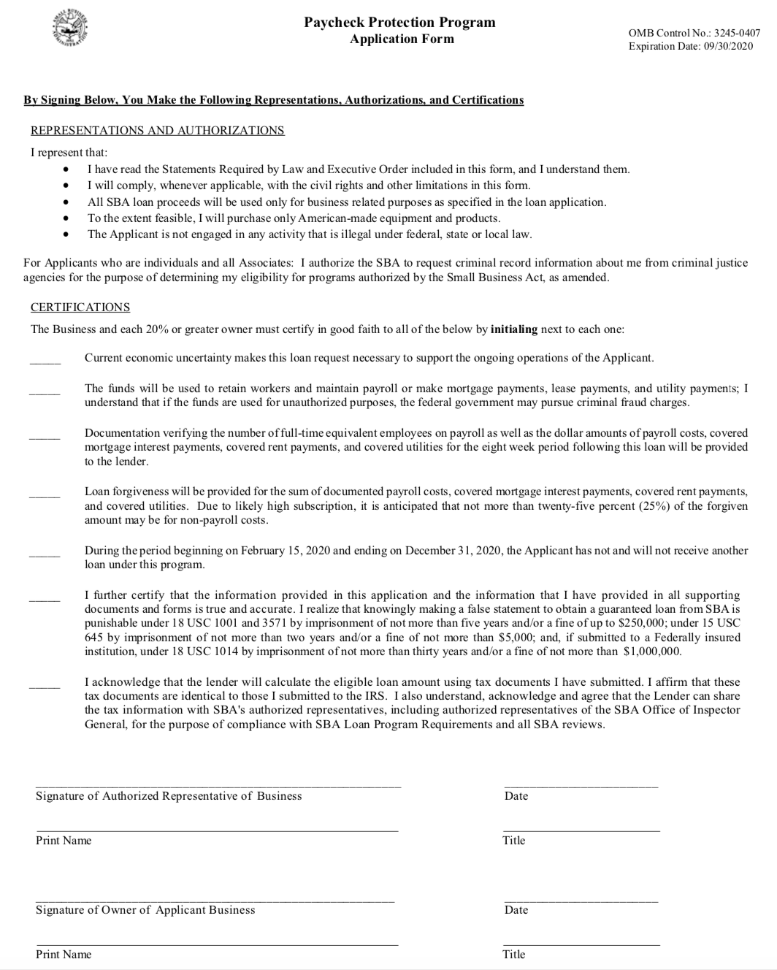
The Application

Slide 25
Questions?
Email: info@americanmedspa.org
www.americanmedspa.org

